Slide 1
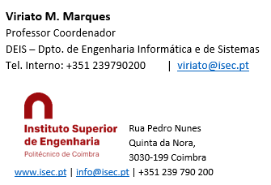
Sistemas de Informação II (LEI) Information Systems (ECS)
Lab Classes
2 – Database Management

Slide 2
The SQL Server (SS) provides 6 main services
Database – basic service, anything won’t go without it
Integration Services – for loading data from sources into databases
Analysis Services – for cube (OLAP) projects and data mining analysis
Reporting Services – to create interactive reports
Agent – to automatically execute some given tasks in a given schedule
Browser – to show the SQL Servers available to connect to
To start and stop them, you use the SQL Server Configuration Manager
Just call it as any other Windows application
NOTICE: If it doesn’t appear, look for mmc.exe. It should be at
C:\Windows\SysWOW64\mmc.exe
Then create a shortcut similar to this one:
C:\Windows\SysWOW64\mmc.exe /32 C:\Windows\SysWOW64\SQLServerManager11.msc

Slide 3
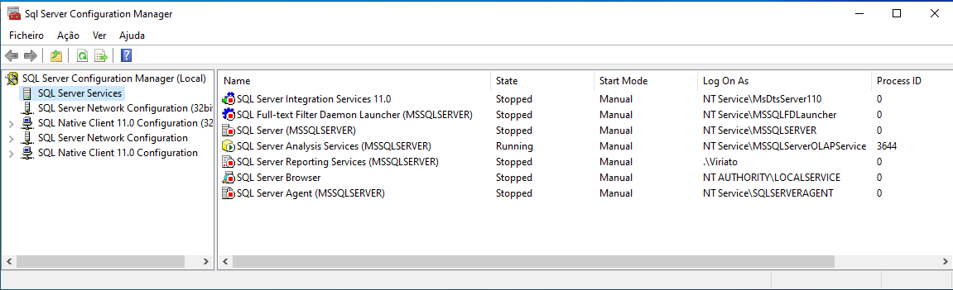
The Configuration Manager (SSCM)
Click on SQL Server Services
By right clicking each service you can start or stop it. Start the SQL Server Service.
The services should be configured to Manual, as this prevents your PC to start them automatically after every reset
There are also some Network configurations, but we won’t use them here
NOTICE: There may be little differences between SS versions. The reporting services, for example, may be not visible, but Analysis and Integration Services must be there.

Slide 4
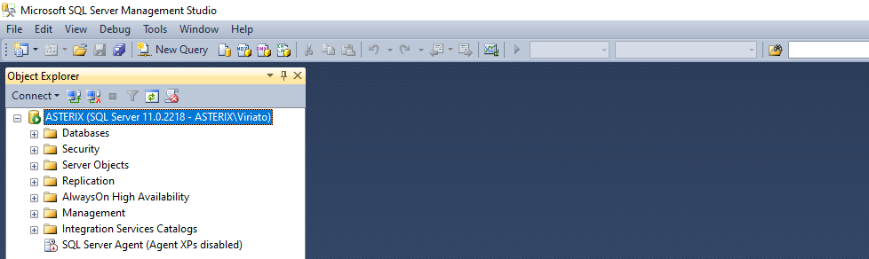
The Management Studio (SSMS)
The management studio allows to create and manage databases, schemas, security, task scheduling, queries, and a lot more …
Call it as a normal Windows Program and login as explained on the Installation slides, by Windows or SQL Server authentication
The SSMS looks like this. In this example the server name is ASTERIX
By expanding the “+” of Databases you’ll be able to manage (new) DBs and schemas

Slide 5
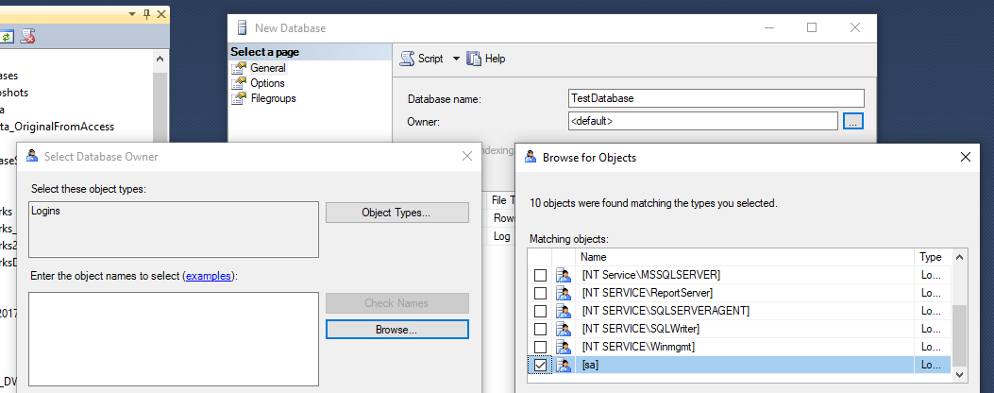
Creating a Database
Expand the “+” on the left of Databases.
Right click Databases, New Database, and give it a name. For the owner, choose browse and “sa” (just to have all the possible permissions)
The other configurations have to do with location, space increments. Accept the defaults.

Slide 6
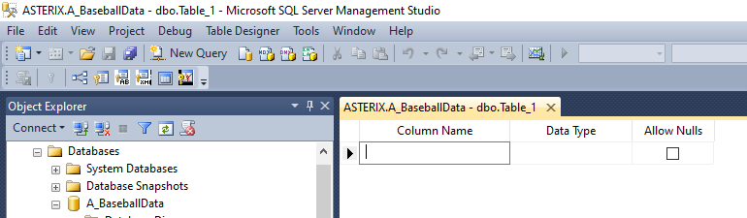
Creating the tables of a database
After creating the DB, if it doesn’t appear on the Object Explorer, right click Databases and Refresh
To create a table on your database:
Expand it by clicking on the “+” sign on the left of its name
Right click Tables, New Table
Now you can create each column of the table, select the datatype and decide if it allows nulls or not

Slide 7
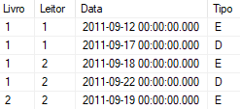
Some Data Types
There are many data types in SS, but the main are the following:
Int – an integer. If you want it to autoincrement automatically after each Insert, look at its properties in the bottom of the page, Identity Specification and check Is Identity
Decimal – a decimal number
Char and Varchar – the former is a string of fixed maximum length, and really uses it in the table. The second is the same, but uses only the necessary number of characters
nChar and nVarchar – The same as above, but more powerfull as they use Unicode. IMPORTANT NOTICE: if you try to convert from char to nchar, you’ll get an error or a warning, at least. Take care, this is a common error in the Integration Services Projects!
Date, Time and DateTime – The former is a date, the second a time, and the third concatenates a date with a time.
The figure shows two integer fileds, a datetime and a char(1)

Slide 8
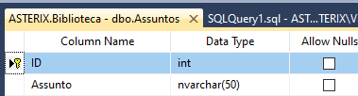
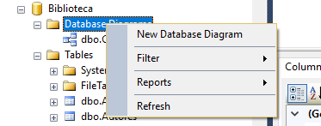
Primary, Foreign Keys and Diagrams (1)
To create the primary key (PK) right click on the left of the attribute and Set Primary Key (or Remove Primary Key)
If the key is concatenated (i.e. several attributes) press the control key and click on the left of the attributes. Then right click and Set Primary Key
For foreign keys, the easiest way it is to begin by creating a diagram of the database
NOTICE: if you get an error saying that the diagram can’t be created, right click the database, properties, owner, and choose “sa” as the owner of the database. Then try again.

Slide 9
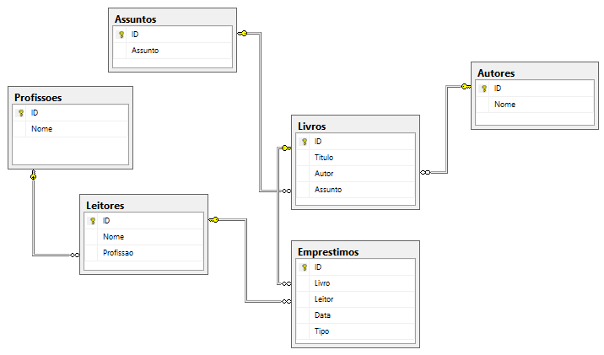
Primary, Foreign Keys and Diagrams (2)
The system will ask what tables to add to the diagram. For small projects select them all
Once the diagram is created, for creating a foreign key you just have to drag and drop from the field that is the FK, to the referenced table (parent table). Some dialog boxes will show up. You can read them and confirm
To delete a relationship click on de connection and Delete
Then close the diagram and save it

Slide 10
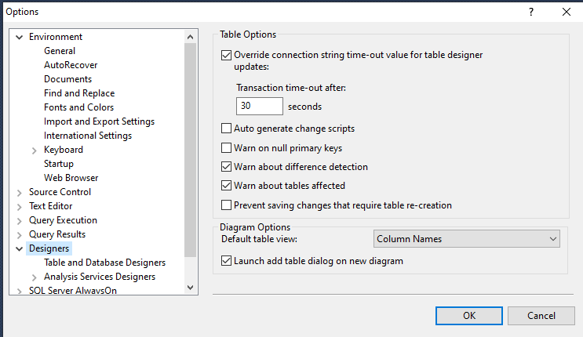
Allowing Changes in Tables and Relationships
Once the tables and keys are created, SS won’t let you do deep changes in the DB structure, for the sake of security and data loss avoidance.
However, here, in a pedagogical environment, we will allow every structure change. To do this:
On the main menu select Tools -> Designers
On the form that will show, uncheck the “Prevent saving changes that require table recreation”
After this you will be able to alter, delete and create tables, PK’s and FK’s as needed

Slide 11
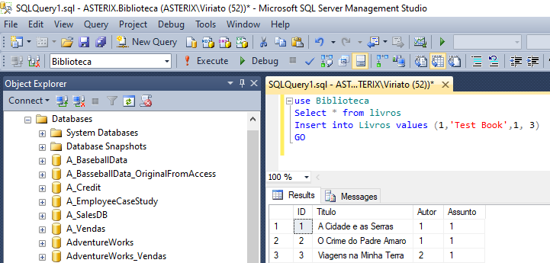
Queries and Scripts (1)
The SSMS allows to write queries and standard SQL commands
However, Microsoft also developed an extension called Transact SQL that supports functions (string operations, mathematical, date..) and allows the implementation of field and record validation rules, triggers and stored procedures
To write a query:
Click New Query
Write the query: in general you begin by “Use [DB name]” followed by any commands. You can mix select, insert, alter table… any command in the same “script”. Strings are between quotes ‘..’
Click Execute or press F5
The query executes and the results are shown

Slide 12
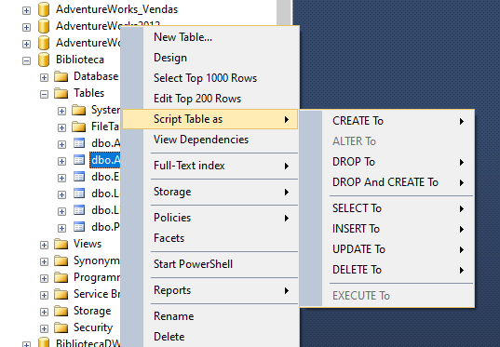
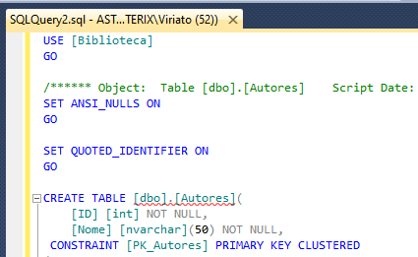
Queries and Scripts (2)
The complete Transact SQL can be quite complex, but generally you can simplify it and use the standard commands only
To see how to create a table, PK’s, FKs, insert into, delete or update, expand the database name, then expand its Tables separator, right click on the table name you wish and choose “Script Table As”. You can get any script type on the query window, clipboard or save it into a text file.

Slide 13
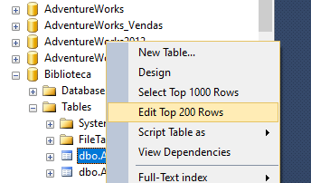
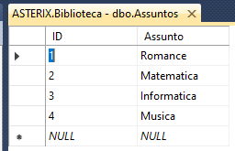
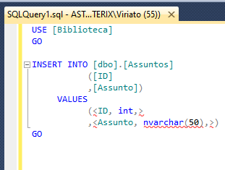
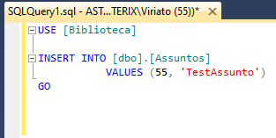
Insert, Delete and Update tables
To fill a table with data, expand Databses, expand your database tables, right click on the table and select “Edit the top 200 rows”
You may then directly edit each row of the table
Instead of this, you may also right click the table, choose “Script Table as INSERT”, choose the Query Window as output
You’ll get a template of the Insert statement that you can edit and repeat for every line of data needed
Similar operations can be performed for update and delete

Slide 14
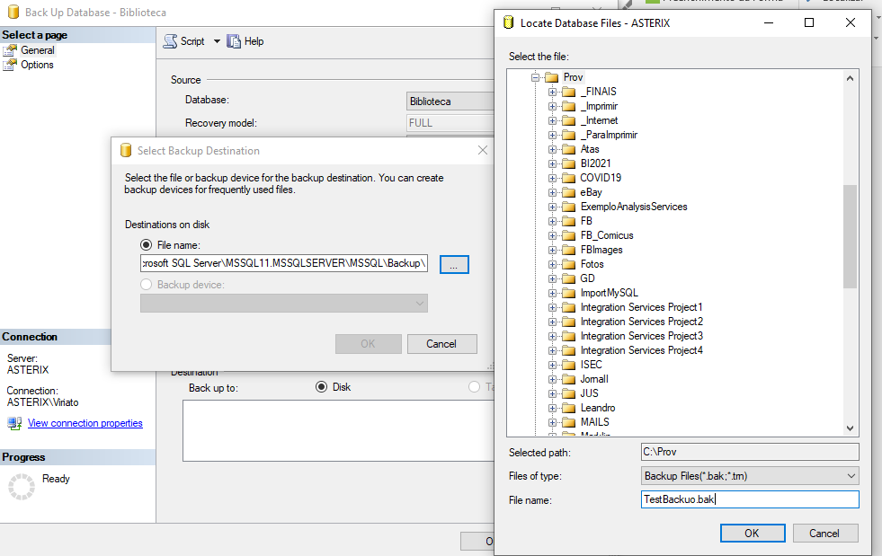
Backup and Restore (1)
Backup and restore of a DB are needed for security and for copying a database between different PC’s. Right click the DB, Tasks, and then Backup or Restore
This is the only way to copy a DB between PC’s of colleagues of the same work group, for example
Backup is self-explanatory
However, keep in mind:
Place the backup into a “normal” folder, not the root, desktop, or special such as Users or Windows
The backup file must have “bak” extension so that the restore recognizes it. You must explicitly write this file extension!

Slide 15
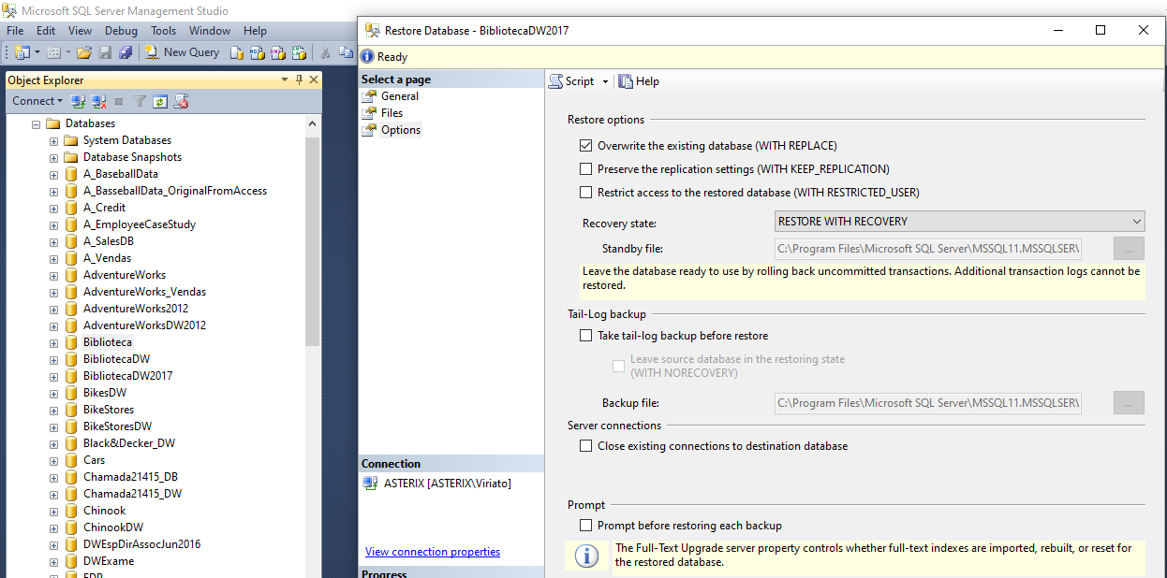
Backup and Restore (2)
The restore is also self-explanatory
However, after specifying where the backup is and so on, you must select the Options separator to configure 2 parameters:
Check the “Overwrite the existing database”
Uncheck the “Take tail-log backup befores restoring”
1) Ensures that the old database is destroyed and replaced by the backup even if it has a different structure
2) Tells SS to ignore a log file where it takes care of the performed backups. Need to uncheck if the destination computer is diferent from the source

Slide 16
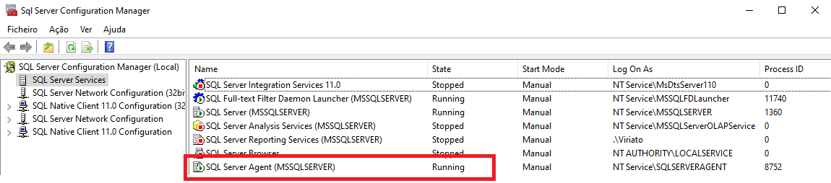
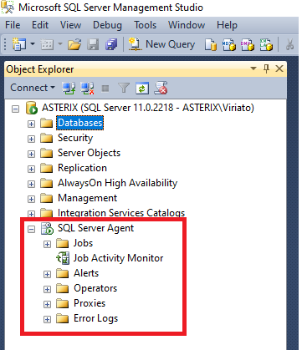
The SQL Server Agent
Start the SS Agent service using the SS Configuration Manager
The Agent is a service that allows to schedule some DB jobs
We’ll use it later to schedule data reading from a source and data writing into a destination
These will be done with an Integration Services Project, commonly called ETL – Extract Transform and Load
We’ll explore it later.

Slide 17
Database Management
THE END

